Slide 1
Payment Behavior Insights
BUY NOW
BUY NOW
BUY NOW
Presented By:
Aaya Ali
Mariam Taj M.
Hussain Ali
Mustafa Ali
BUY NOW

Slide 2
Client Requirement
The client requires a clear way to track product prices across categories to identify trends, variations, and inconsistencies that may impact sales and customer satisfaction. By analyzing minimum, maximum, and average price ranges, Olist can highlight categories with imbalanced pricing, detect products where shipping costs outweigh the product value, and uncover opportunities for better pricing strategies. These insights will support the client in improving pricing policies, optimizing product positioning, and enhancing competitiveness, ultimately leading to higher revenue and stronger customer trust.

Slide 3
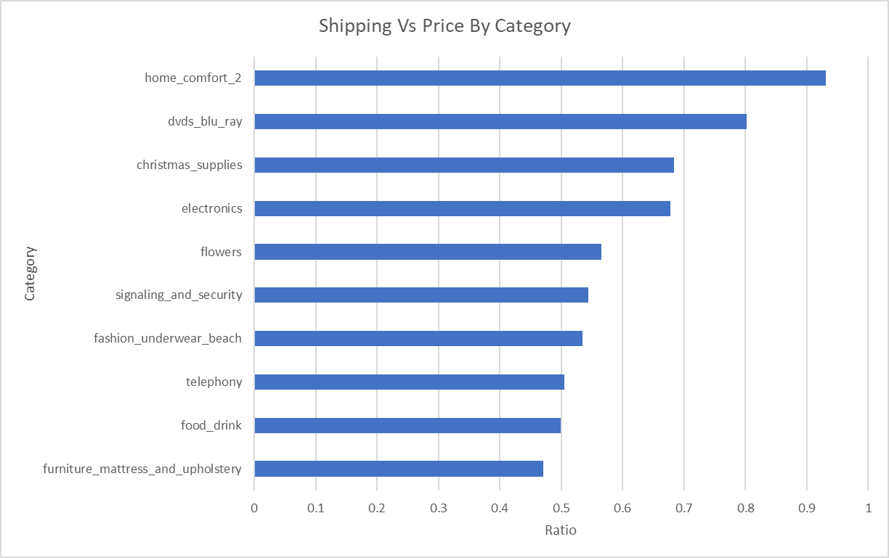
Price Vs. Shipping
Home Comfort 2
Furniture
High Category Ratio
Less Category Ratio

Slide 4
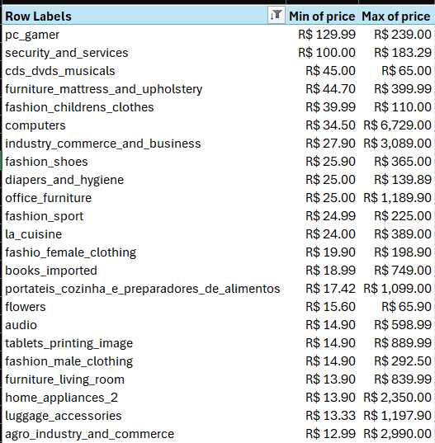
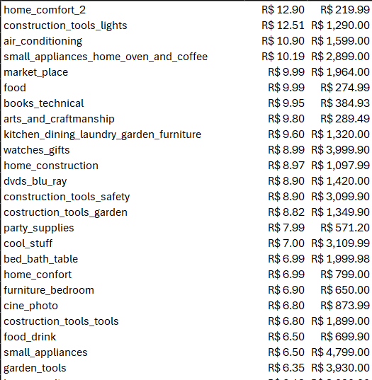
Range of price for each product category

Slide 5
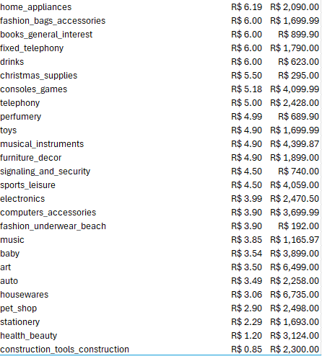
Range of price for each product category

Slide 6
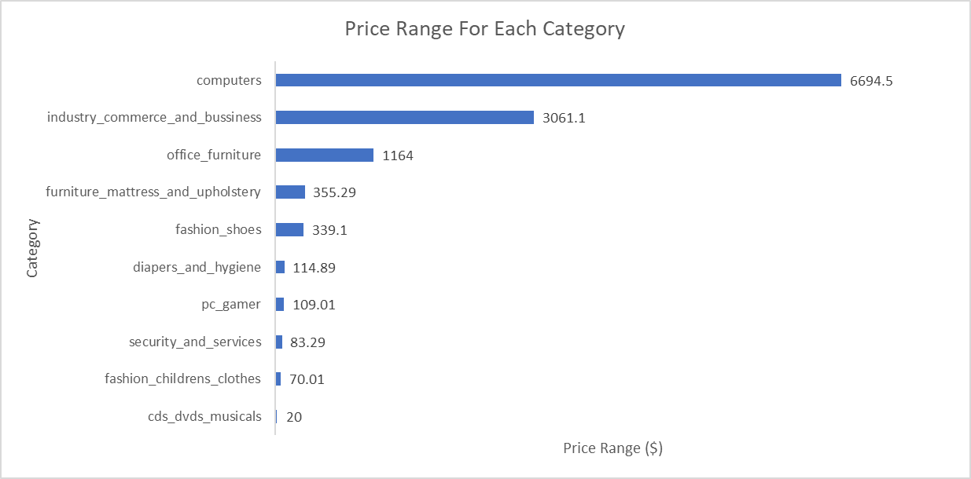
Range of price for each product category

Slide 7
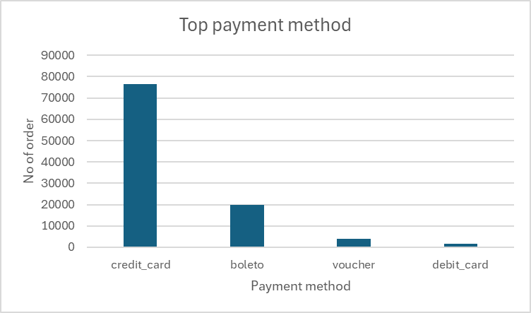
Most Used Payment Type
Credit Card
Debit Card
High Payment Type
Less Payment Type

Slide 8
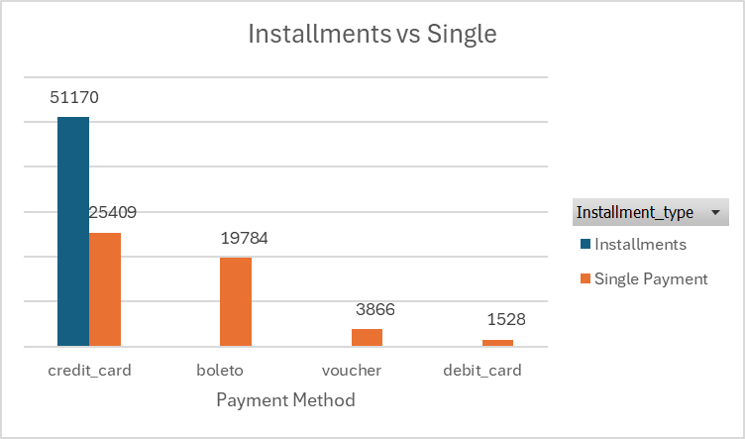
Installments in Payment Method

Slide 9
Installments in Payment Method

Slide 10
Annual Revenue

Slide 11
Seasonal Trends

Slide 13
Recommendations
Offer & promotions
Development
Revenue peaks around March–August. Use promotions during slow months to increase profits.
Reduce high shipping costs, especially for low-priced products, improve customer convenience, and increase profit margins in categories with low shipping-to-price ratios.

Slide 14
Part 2 Final Result
BUY NOW
BUY NOW
BUY NOW
BUY NOW

Slide 15
Client Requirement
The client requires a clear way to track product prices across categories to identify trends, variations, and inconsistencies that may impact sales and customer satisfaction.
By analyzing product price ranges, discounts, shipping costs, and installments, Olist can improve pricing policies, optimize product positioning, and enhance competitiveness.

Slide 16
Price Ranges

Slide 17
Range of price for each product category

Slide 18
Range of price for each product category

Slide 19
Lowest change of price (product)
Product category
Healthy beauty
Healthy beauty
Fashion bags accessories
electronics
watches gifts
Product_id | Change in price | Count of product_id
4c2394abfbac7ff59ec7a420918562fa | R$ 0.00 | 123(During 8 months)
e0cf79767c5b016251fe139915c59a26 | R$ 0.00 | 137(During 10 months)
d017a2151d543a9885604dc62a3d9dcc | R$ 0.00 | 140(During 14 months)
7ce94ab189134e2d3c05f496d635419c | R$ 0.00 | 106(During 7 months)
A92930c327948861c015c919a0bcb4a8 | R$ 1.00 | 160(During 15 months)

Slide 20
Highest change of price (product)
watches_gifts
watches_gifts
watches_gifts
furniture_decor
watches_gifts

Slide 21
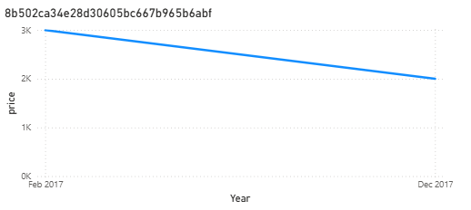
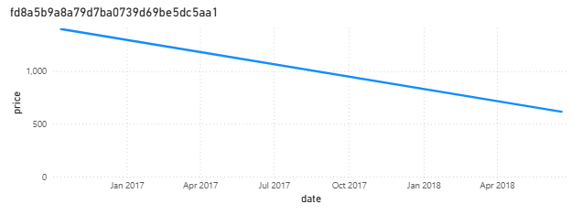
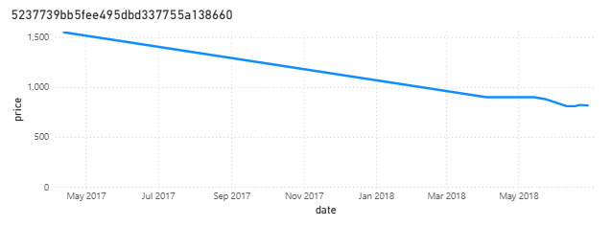
Change of price over the year

Slide 22
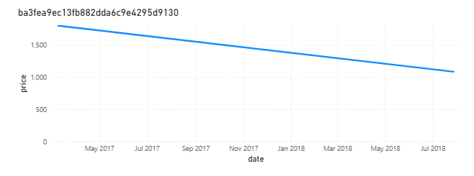
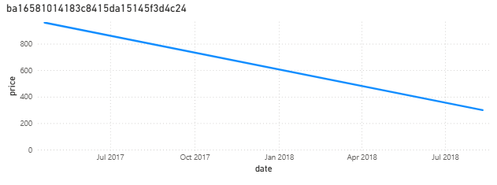
Change of price over the year

Slide 23
Discounts

Slide 24
Annual Revenue

Slide 25
Seasonal Trends

Slide 27
Average vouchers used per customer: 2

Slide 29
Shipping

Slide 30
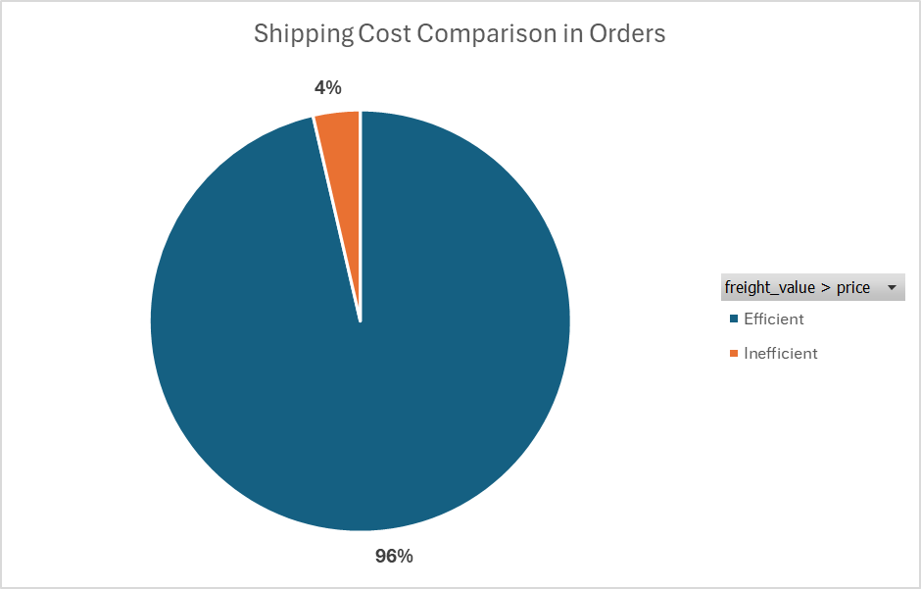
Shipping cost in order

Slide 31
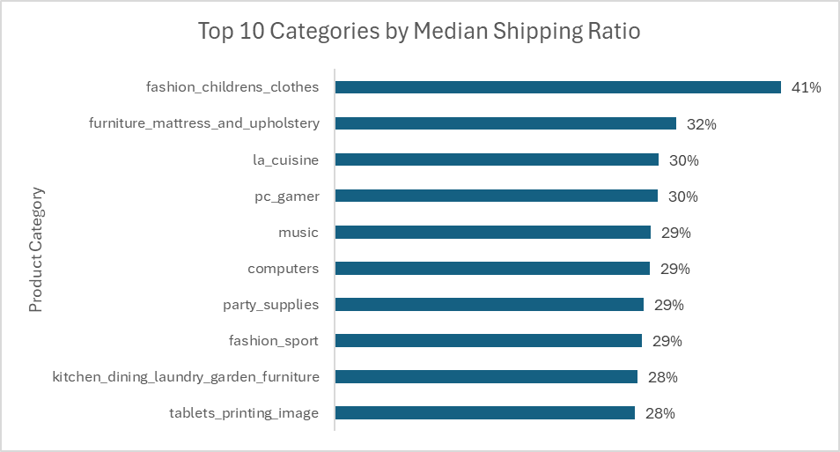
Median Ratio by Category

Slide 32
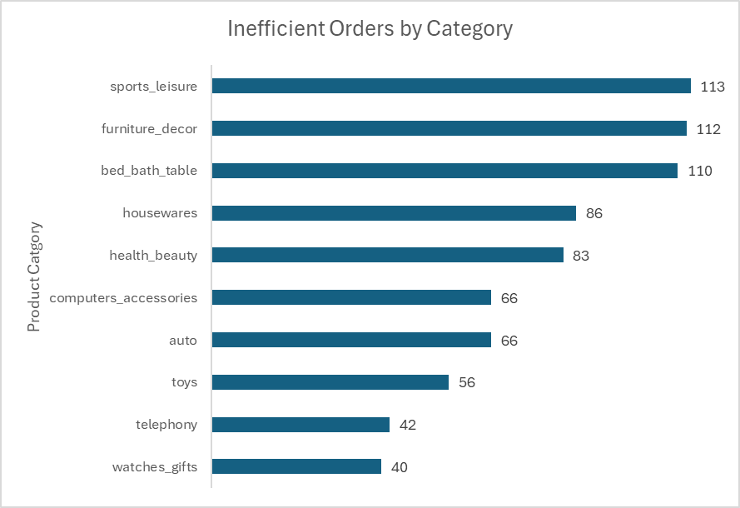
Top 10 Category by high shipping charge
Product Category | Max of price | Max of freight value
furniture_decor | R$ 170 | R$ 207
telephony | R$ 144 | R$ 269
housewares | R$ 123 | R$ 167
watches_gifts | R$ 120 | R$ 167
auto | R$ 108 | R$ 110
health_beauty | R$ 100 | R$ 155
computers_accessories | R$ 79 | R$ 141
toys | R$ 67 | R$ 82
sports_leisure | R$ 60 | R$ 112
bed_bath_table | R$ 59 | R$ 71

Slide 33
Installments

Slide 34
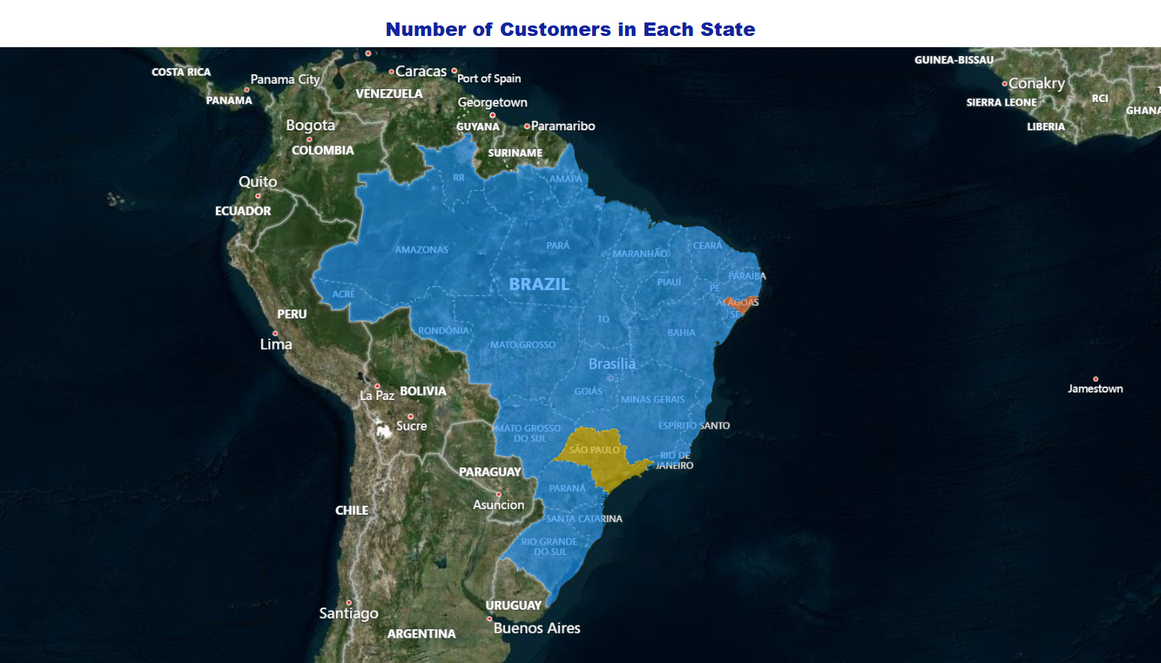
Location & Customers
The highest Number of Customers is in SP State.
State data is ambiguous — two-letter codes (e.g., “AL”) could mean Brazil or USA. We cannot fully differentiate locations for geographic analysis.

Slide 35
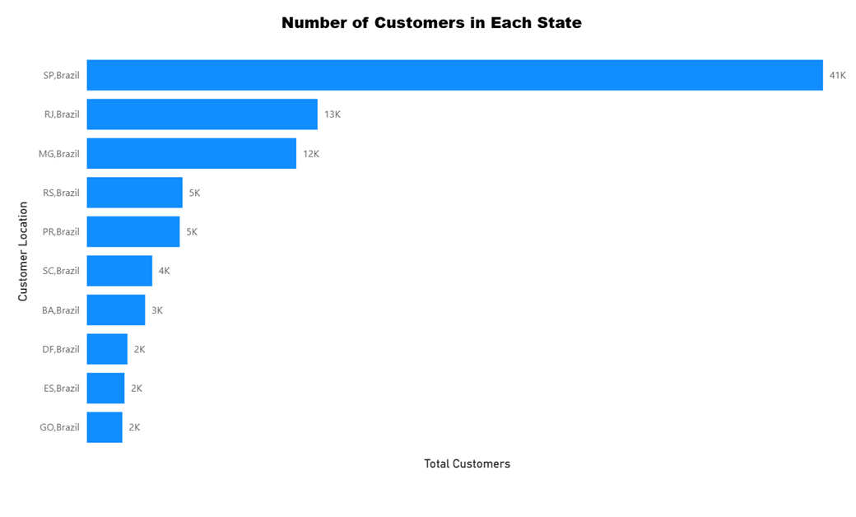
Location & Customers
The higher Number of Customers is in SP with 41K.
The least Number of Customers is in GO with 2K.

Slide 36
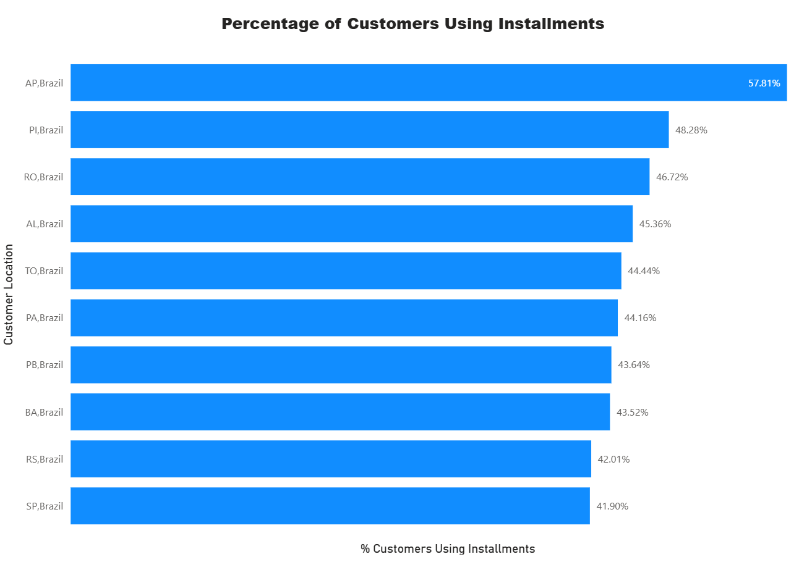
Installments & Customer
• The highest percentage of customers is in AP with 57.81%.

Slide 37
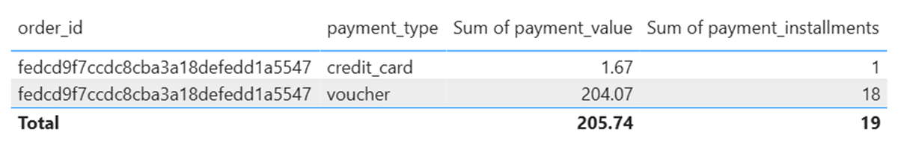
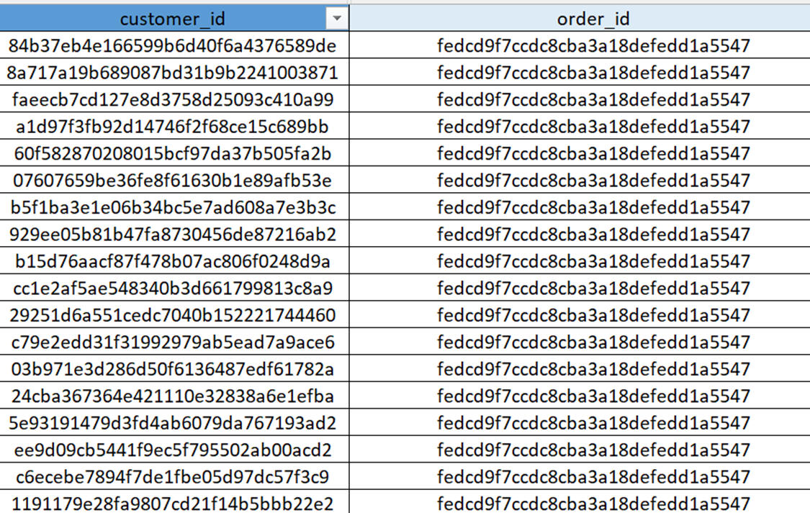
Order Id Repeated????

Slide 38
Order Id Repeated????

Slide 39
Order Id Repeated????

Slide 40
Order Id Repeated????

Slide 41



Conclusion & Recommendations
Price Ranges
Discounts
Analyzing price trends supports better pricing strategies and customer satisfaction, it is recommended to focus on products with stable prices to ensure consistent profit.
Revenue peaks around March–August. Promotions have a direct positive impact on the revenue. Use promotions during slow months to increase profits.
Shipping
Installments
Add a Click & Collect service so customers can pick up orders easily save money on shipping.
Add a country column to distinguish between Brazil and USA states.
Your company should review the repeated order with the technical team.

Slide 42
Thank You Any Question?

